Slide 1


Equity, Equality, Diversity, and Inclusion at Trinity
Joel McKeever | Equality Officer
he/him

Slide 2
Equality, Diversity, and Inclusion Team
Vice-President for EEDI
Prof. Lorraine Leeson
Equality Officer
Joel McKeever
EDI Data Analyst / Athena Swan Officer
Samantha Williams
EDI Executive Officer
Susan Cantwell
Irish Sign Language Interpreter
Bernadette Williams
Assistant Irish Sign Language Interpreter
Gemma Shannon
Race Equality Officer
Head of EDI
Dr Siobán O’Brien-Green

Slide 3

What We Do
Actively working to create a fair and equitable Trinity community
Leading local and national conversations that underpin our responsibility to create a meaningfully equitable and inclusive society
Working at every level, from the daily life of students to the long-term future of the university
More needs to be done

Slide 4




Why We Do It
Trinity’s Statutes (basic law) establishes that the College:
“Embraces the principles of liberty, equality, equity and justice”
Trinity’s Strategy 2025-30 commits to:
“Under our Public Sector and Human Rights Duty, to eliminate discrimination, promote equality of opportunity and protect the human rights of its members…we take action to embed a culture of equality, inclusion and respect for human rights across our community and in how we work.”

Slide 5


Slide 6

Equal Status Grounds

Slide 7
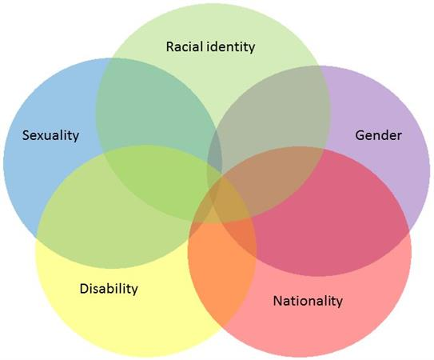
An intersectional approach

Slide 8
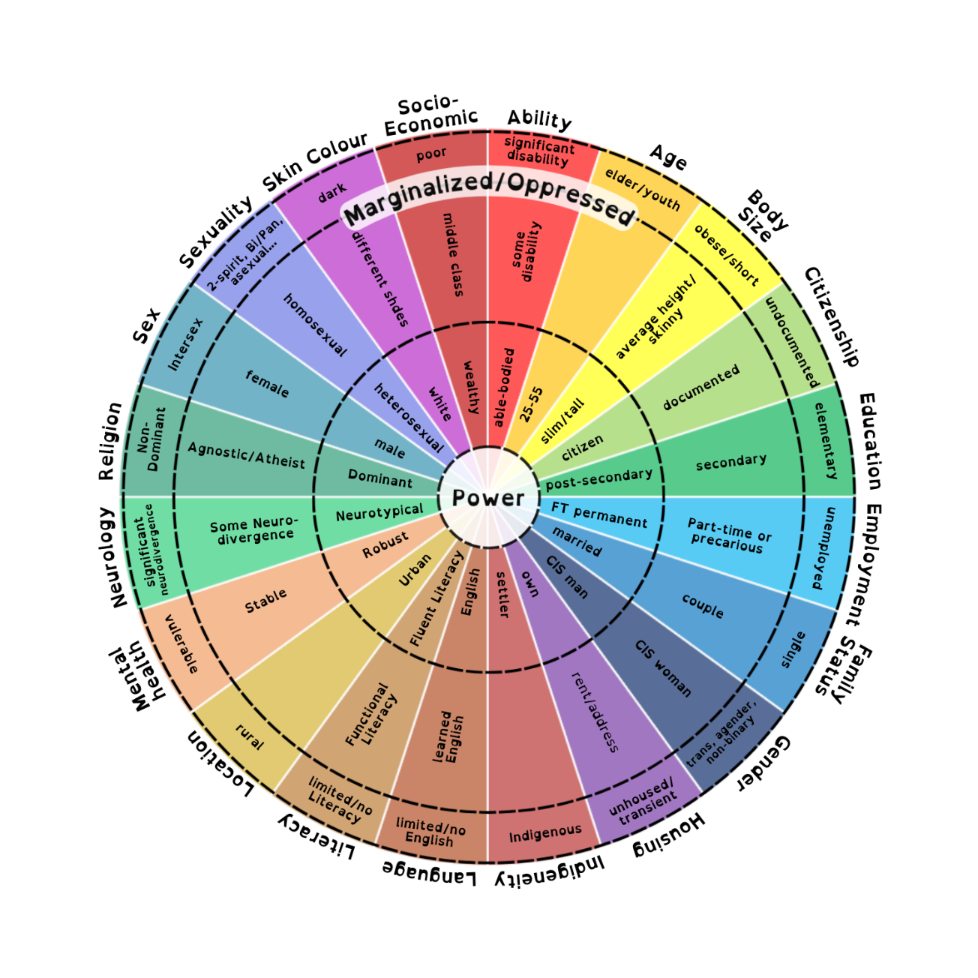
An intersectional approach

Slide 9
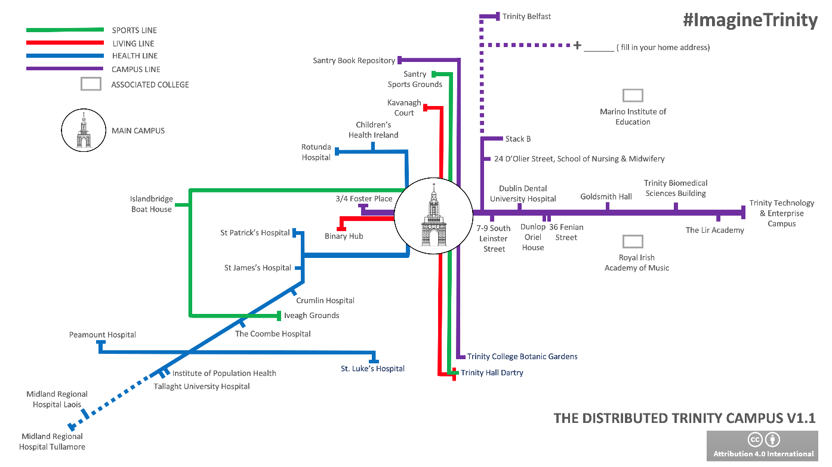
A whole of Trinity approach – from Belfast to Birr

Slide 10
Who does it apply to?
The Equality Policy applies to all members of the Trinity community. This includes, but is not limited to:
Staff
Students
Guest Lecturers
Alumni (in relation to University and on-campus interactions)
Any person on occasional/temporary/sessional work
Contractors and Sub-contractors
Consultants
Service users e.g. campus visitors to the Book of Kells, customers in Trinity shops and cafes, conference attendees, etc.
The Visitors of and to the University and its associated bodies.

Slide 11
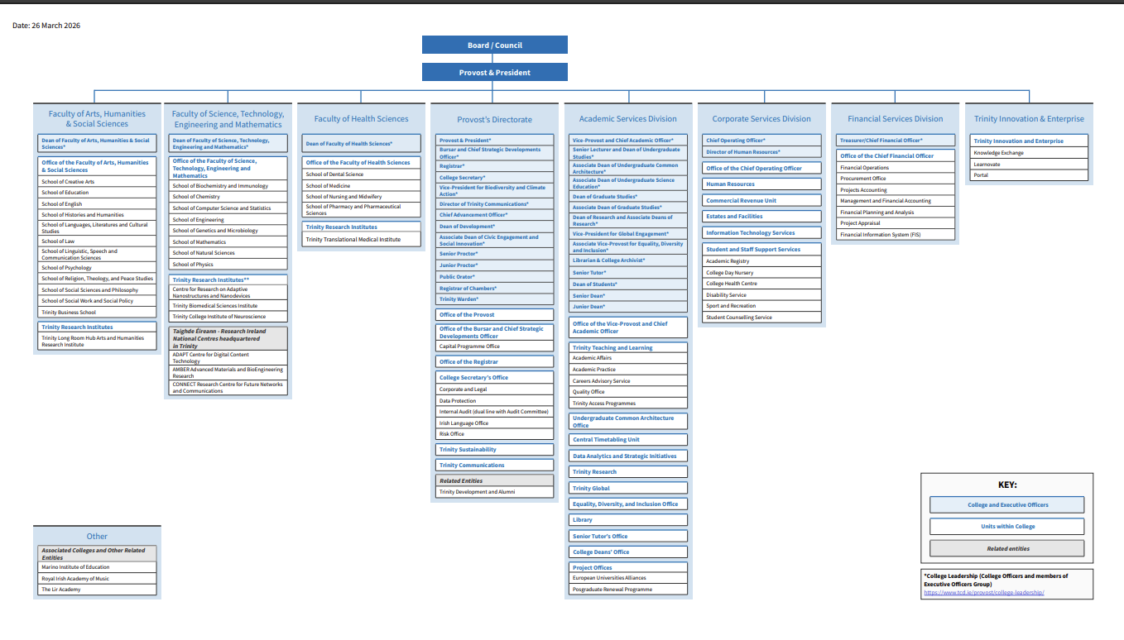
Who does it apply to?

Slide 12
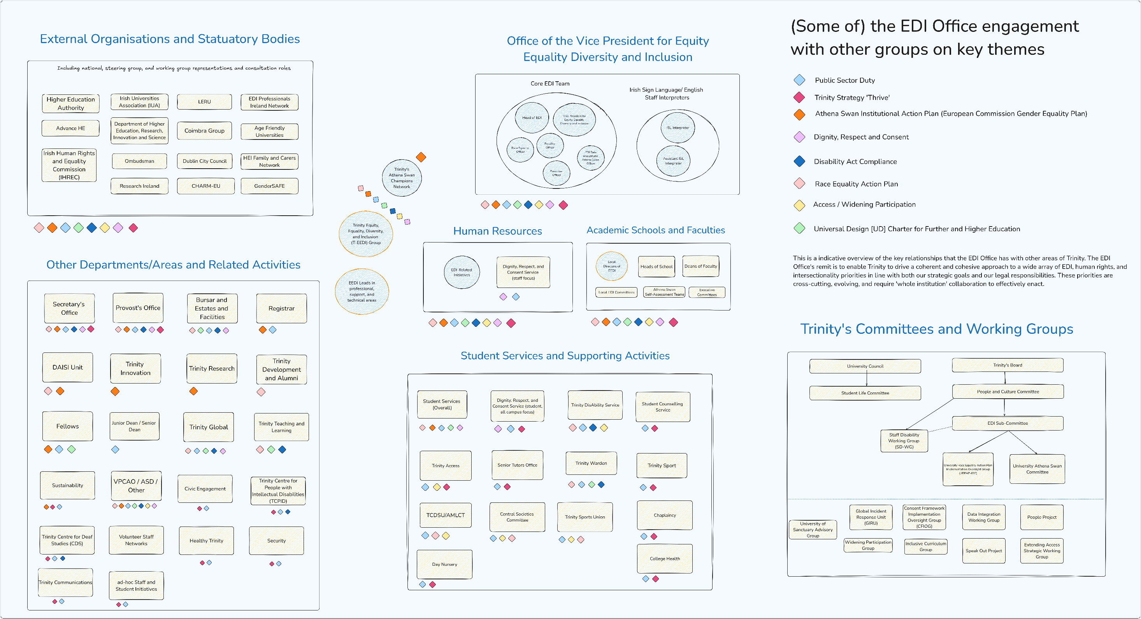

Slide 13

Key Policies in Trinity
Trinity’s Equality Policy (major revisions in 2026)
Dignity and Respect Policy & Sexual Misconduct Policy
Policy on Supports for Student Parents, Student Carers and Students Experiencing Pregnancy
Gender Identity and Gender Expression Policy
Race Equality Action Plan
Disability-related policies and procedures including:
  Accessible Information Policy
  Reasonable Accommodation Policy for students
  Irish Sign Language (ISL)/English Procedures

Slide 14
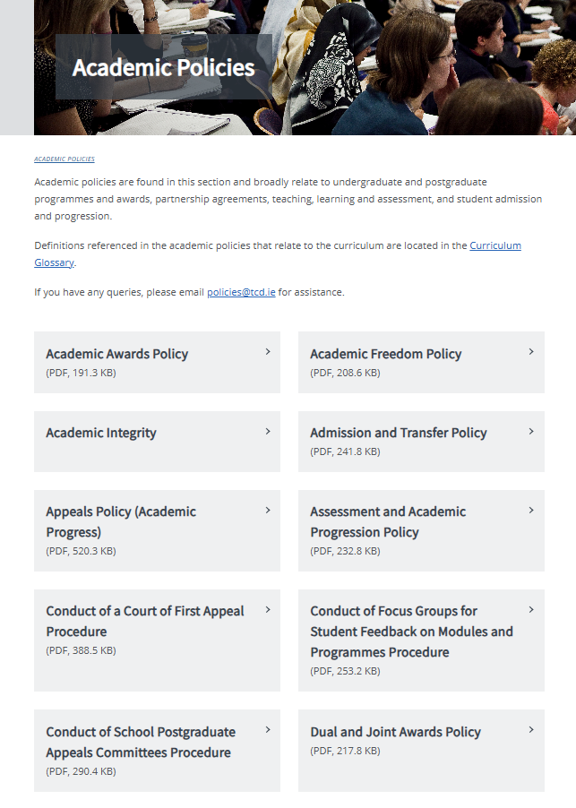
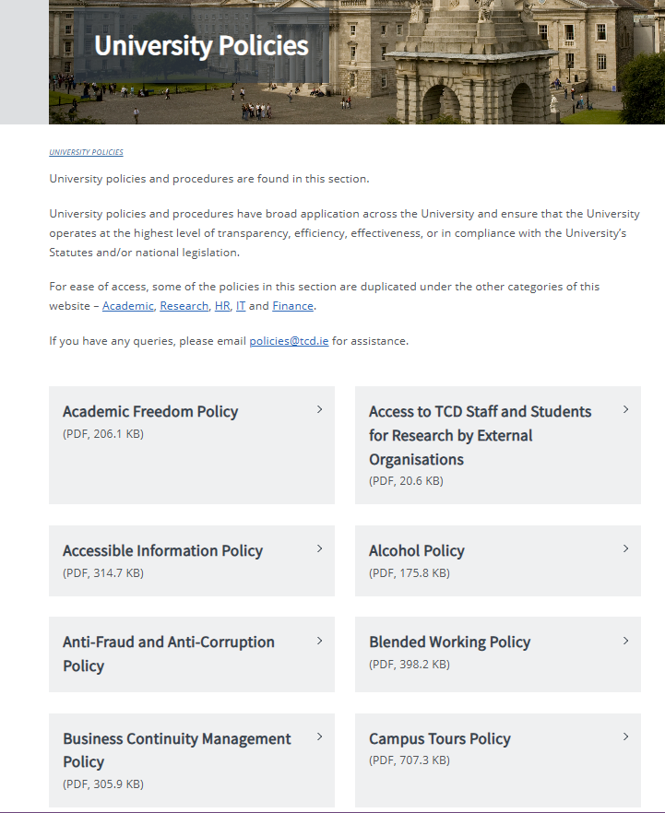
Key Policies in Trinity

Slide 15
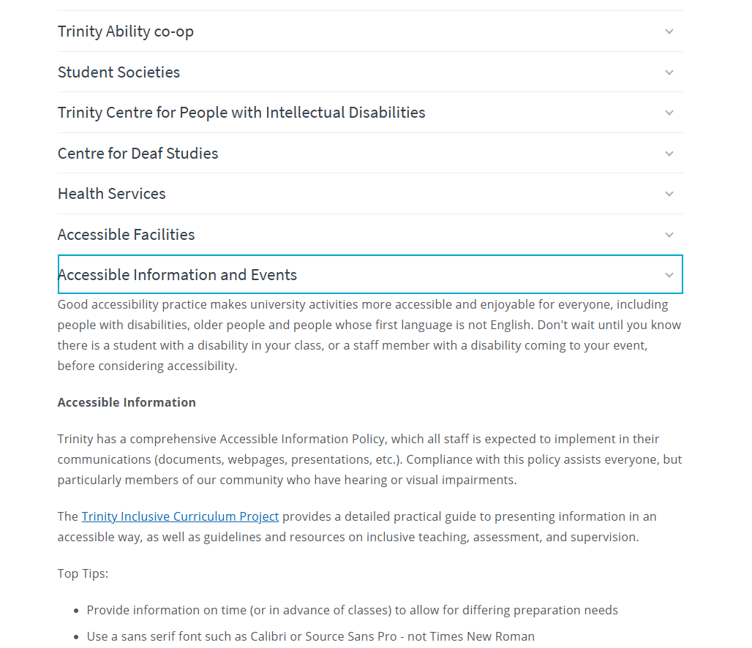
EDI Office: How does it Work?

Slide 16

Resources
EDI-related training and CPD
EDI in Higher Education
Let’s Talk about Race
EMBRACED
Unconscious Bias
Dignity and Respect training
EDI Office consultations
LinkedIn Learning
Self-directed & good practice resources on EDI website
EDI Office website
Directors of EEDI and EEDI Leads
Student Societies, Sports Clubs, TCDSU/AMLCT
HR Partners
Dignity, Respect, and Consent Service
Student Tutor, PG Advisory Service, and Academic Schools
Trinity support network
Communities within Dublin
Trinity Policy Hub https://www.tcd.ie/about/policies/
Need something more specific? Ask us at equality@tcd.ie

Slide 17
Q&A?
For more information on EDI at Trinity visit www.tcd.ie/equality

